Slide 1

India Data Center (DC) Landscape: A Comprehensive Overview

Slide 2
TABLE OF CONTENTS
1
OVERVIEW OF INDIA DATA CENTER (DC) MARKET
3
2
DATA CENTER (DC) HOTSPOTS IN INDIA
8
3
DATA CENTER (DC) OPERATORS
11
4
DATA LOCALIZATION LAWS AND REGULATIONS IN INDIA
14
5
VALUE CHAIN FOR THE DATA CENTER MARKET IN INDIA
16
6
PLANNED AND UPCOMING DATA CENTER OPERATIONS IN INDIA
18
7
FUTURE OUTLOOK OF INDIA DC LANDSCAPE
20

Slide 3

OVERVIEW OF INDIA DATA CENTER (DC) MARKET

Slide 4
OVERVIEW OF INDIA DATA CENTER (DC) MARKET (1/4)
DEFINITION
DATA CENTER
A data center is a physical room, building or facility that houses IT infrastructure for building, running and delivering applications and services. It also stores and manages the data associated with those applications and services
COLOCATION DATA CENTER
A colocation data center, often referred to as a ‘colo,’ is any large datacenter facility that rents out rack space to third parties for their servers or other network equipment
The hardware is usually owned by the company’s themselves, and simply housed (and sometimes maintained) by the data center staff
DATA CENTER VS. COLOCATION DATA CENTER
The primary difference between a data center and a colocation data center is that colocation refers to a service while a data center is a physical place
COLOCATION VS. CLOUD
IT hardware is hosted within a data center for both colocation and cloud services. However, a colocation tenant retains ownership and ultimate control over their servers and knows where they're located
A cloud provider, on the other hand, is responsible for all the hardware effectively leased from them, with the data storage customer not necessarily aware of specific data center location beyond country in many cases

Slide 5
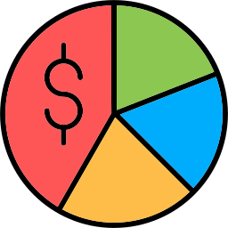


OVERVIEW OF INDIA DATA CENTER (DC) MARKET (2/4)
INDIA DATA CENTER (DC) MARKET SNAPSHOT
Market Size (2021):
USD 4.4 Billion
DC Capacity (2021):
935.4 MW
Market Size (2027):
USD 10.1 Billion
DC Capacity (2027):
2,696.7 MW
CAGR (2022-2027):
15.1%
CAGR (2022-2027):
20.1%
Source: India Brand Equity Foundation (IBEF), Research Reports, Analysis
In terms of value, India data center market will soar from $4.4 billion in 2021 to a projected $10.1 billion by 2027, boasting a 15.1% CAGR throughout 2022-2027
In terms of capacity, the data center capacity in India is predicted to reach 2,696.7 MW by 2027 from 935.4 MW in 2021, at a CAGR of 20.1% during a forecast period (2022-2027)
India's data center landscape is experiencing rapid growth, driven by a surge in digital transformation, a high internet penetration, increased cloud adoption, data localization regulations, the growing presence of hyperscalers, and technological advancements. Also, a surge in online retail, the emergence of startups, the government investment in IT sector, proliferation of connected devices, and increasing focus on 5G infrastructure are creating further opportunities for the growth of India data center market

Slide 6





OVERVIEW OF INDIA DATA CENTER (DC) MARKET (3/4)
FACTORS AFFECTING THE INDIA DATA CENTER (DC) MARKET GROWTH
Surge in Digital Transformation
High Internet Penetration
Increased Cloud Adoption
Data Localization Regulations
Growing Presence of Hyperscalers
Technological Advancements
DRIVERS
High Operational Costs
Infrastructure Challenges
Lack of Skilled Professionals
RESTRAINTS
MARKET DYNAMICS
Surge in Online Retail
Emergence of Startups
Government Investment in IT Sector
Proliferation of Connected Devices
Increasing Focus on 5G Infrastructure
OPPORTUNITIES
Rapid Technological Changes
Rise in Cyber Threats
Increasing Competition among Data Center Providers
CHALLENGES
Increased Demand for Colocation Services
Rise of Hyperscale Data Centers
Increasing Adoption of Hybrid Cloud Solutions
Increasing Integration of AI and ML Technologies
Prioritizing Green Data Centers
Integration of Liquid Cooling Technologies
TRENDS

Slide 7








OVERVIEW OF INDIA DATA CENTER (DC) MARKET (4/4)
DRIVING FORCES FOR DATA CENTER DEMAND IN INDIA
India is rapidly establishing itself as a key player in the global data center market, fueled by its burgeoning economy and tech-savvy population. The country's economic growth is significantly driven by an unprecedented surge in digital adoption across various industries, leading to a massive increase in data consumption. Notably, India holds the highest mobile data consumption in the world, and this trend is only set to rise
To accommodate the expanding demands of its vast digital population, the data center infrastructure must grow at an accelerated pace. The proliferation of data generated by smartphones, e-commerce platforms, social media, digital education, and online payment systems is a major contributor to the impressive expansion of the Indian data center market.
Industries such as social media, gaming, and over-the-top (OTT) streaming are also significant drivers of capacity growth. As a result, the data center market is expected to witness numerous growth-oriented projects across various sectors, including banking, insurance, telecommunications, IT, and IT-enabled services (ITeS). This dynamic environment is fostering a healthy trajectory for the Indian data center market, making it a focal point for investment and innovation in the coming years.
Number of Users in India
135.4 Mn
596.6 Mn
392.3 Mn
27.3 Mn
751.5 Mn
5.5 Mn
214.6 Mn
476.1 Mn
The emergence of data-intensive technologies such as Big Data and the Internet of Things (IoT) is creating an exponential demand for data collection and storage solutions, further propelling the market's growth. A central theme driving this expansion is the immense digital requirements of India’s emerging economy, which boasts a large and diverse population.
The growing presence of hyperscale data center providers, coupled with increased internet connectivity and a heightened focus on data privacy, is shaping the landscape. Additionally, the complexities of IT infrastructure—stemming from virtualization and consolidation—alongside various cost pressures, are pushing enterprises to consider third-party data center services.

Slide 8
DATA CENTER (DC) HOTSPOTS IN INDIA

Slide 9
DATA CENTER (DC) HOTSPOTS IN INDIA (1/2)
DATA CENTER (DC) DISTRIBUTION IN INDIA
SR NO | MARKET | DATA CENTERS
1 | Mumbai | 39
2 | Bengaluru | 31
3 | Chennai | 27
4 | Hyderabad | 25
5 | Pune | 18
6 | Others | 104
 | Total | 244
Source: DataCenterMap.com, India Brand Equity Foundation (IBEF), Company Websites
India currently boasts over 240 data centers across the country, a number projected to grow as the nation aims to establish itself as a truly digital economy.
Leading the way is Mumbai, home to 39 data centers, which represent a 16% market share. Following closely are Bengaluru with 31 data centers (13%), Chennai with 27 (11%), Hyderabad with 25 (10%), and Pune with 18 (7%). These cities are rapidly emerging as key players in India's data center landscape.
Also, Indian corporate leaders and foreign investors are focusing their investments on Tier 1 cities, where most of the country’s data centers are currently situated. This trend leaves significant market opportunities in Tier 2 and Tier 3 cities largely untapped. As a result, Tier 2 cities are expected to increasingly invest in Edge Data Center use cases to enhance the digital experience for their residents.

Slide 10



DATA CENTER (DC) HOTSPOTS IN INDIA (2/2)
TOP DATA CENTER (DC) CITIES IN INDIA, BY CAPACITY (2023)
MARKET | DC CAPACITY (MW)
Mumbai | 649.4
Bengaluru | 199.8
Chennai | 162.4
Delhi NCR | 99.9
Others | 137.4
Total | 1,248.9
Source: DataCenterMap.com, India Brand Equity Foundation (IBEF), Research Reports, Analysis
Mumbai
Bengaluru
Chennai
Mumbai's data center market is a dominant force in India, commanding a substantial 52% market share.
With a robust capacity of 649.4 MW, the city serves as a critical hub for data storage and processing, attracting significant investments from both domestic and international operators.
Bangalore's data center market holds a 16% share of the Indian landscape, showcasing its importance as a key player in the sector.
With a capacity of 199.8 MW, the city is rapidly emerging as a major hub for data storage and processing, fueled by its thriving technology ecosystem and the growing demand for cloud services.
Chennai's data center market accounts for 13% of India's overall share, reflecting its growing significance in the sector.
With a capacity of 162.4 MW, the city is becoming a vital hub for data storage and processing, driven by increasing digital demands from various industries..

Slide 11
DATA CENTER (DC) OPERATORS

Slide 12
DATA CENTER (DC) OPERATORS (1/2)
TOP DATA CENTER (DC) OPERATORS IN INDIA AND THEIR CAPACTITIES
DC OPERATOR | FOUNDED | HEADQUARTERS | CAPACITY (MW) | NO OF DC | TOP DC LOCATION
ST Telemedia Global Data Centres (STT GDC) | 2014 | Mumbai | 315+ | 28 | Mumbai, Ahmedabad, Bengaluru, Chennai, Delhi NCR, Hyderabad, Noida
NTT Ltd. | 1988 | Mumbai | 265+ | 18 | Delhi NCR, Mumbai, Bengaluru, Chennai
CtrlS Datacenters Ltd. | 2008 | Hyderabad | 250+ | 15 | Mumbai, Chennai, Hyderabad, Noida, Bengaluru, Kolkata
Sify Technologies | 1995 | Chennai | 225+ | 14 | Mumbai, Chennai, Noida
Nxtra Data Limited | 2013 | New Delhi | 200+ | 12 | Mumbai, Chennai
Yotta Infrastructure | 2019 | Mumbai | 80+ | 3 | Mumbai, Delhi NCR
Web Werks Data Centers India | 1996 | Mumbai | 40+ | 6 | Mumbai, Pune, Delhi NCR, Bengaluru, Hyderabad
ESDS Software Solution Ltd. | 2005 | Nashik | 35+ | 5 | Nashik, Mumbai, Bangaluru, Mohali

Slide 13
DATA CENTER (DC) OPERATORS (2/2)
TOP DATA CENTER (DC) OPERATORS IN INDIA AND THEIR CAPACTITIES
DC OPERATOR | FOUNDED | HEADQUARTERS | CAPACITY (MW) | NO OF DC | TOP DC LOCATION
Adani ConneX Pvt. Ltd. | 2020 | Ahmedabad | 30+ | 1 | Chennai
NxtGen Datacenter & Cloud Technologies Private Limited | 2012 | Faridabad | 20+ | 4 | Bangalore, Ahmedabad, Faridabad, Mumbai
Equinix, Inc. | 1998 | Mumbai | 15+ | 3 | Mumbai
Cyfuture India Pvt. Ltd. | 2001 | Noida | 15+ | 5 | Jaipur, Noida, Raipur, Bangaluru, Mumbai
Reliance Communications | 2004 | Mumbai | - | 9 | Mumbai, Bangalore, Chennai, Hyderabad
CapitaLand India Trust | 2004 | Bangaluru | - | 4 | Mumbai, Hyderabad, Chennai, Bangaluru
Source: Company Websites, Press Releases, Blogs
The data center market in India is highly fragmented, with numerous players offering their services. Given the competitive landscape, operators must be quick and efficient in delivering their offerings.
Among the prominent data center operators in the country are ST Telemedia Global Data Centres (STT GDC), NTT Ltd., CtrlS Datacenters Ltd., Sify Technologies, and Nxtra Data Limited, among others.

Slide 14
Data Localization Laws and Regulations in India

Slide 15
DATA LOCALIZATION LAWS AND REGULATIONS IN INDIA (1/1)
DATA CENTER RELATED LAWS AND REGULATIONS, BY TOP STATES
MAHARASHTRA
KARNATAKA
TAMIL NADU
Maharashtra IT Policy 2023
Designed to foster innovation, enhance infrastructure, and support the growth of the IT & data center ecosystem in Maharashtra.
Maharashtra Cybersecurity Awareness Guide
Aims to enhance the state’s cybersecurity framework and promote best practices in data protection.
Maharshtra’s IT/ITES Policy 2015
Focuses on promoting IT infrastructure and services in Maharashtra, including data centers.
Maharashtra Shops and Establishments Act 2017
Digital Personal Data Protection Act, 2023 (DPDP Act) (Govt of India)
Karnataka Cybersecurity Policy 2023
Designed to enhance state's cybersecurity framework, ensuring robust protection for its digital infrastructure and data.
Karnataka IT Policy 2020-2025
aims to establish the state as a global leader in IT while specifically promoting the growth of data centers & related infrastructure.
Karnataka Data Center Policy (2022-27)
To create world class data center ecosystem in the state
To develop more than 200 MW Data Center industry by 2025
The Karnataka Innovation Authority Act, 2020
Digital Personal Data Protection Act, 2023 (DPDP Act) (Govt of India)
Tamil Nadu Data Policy 2022
Designed to promote effective data management and utilization across various sectors
Data Center Policy of Tamil Nadu 2021
To position Tamil Nadu as a cost-effective destination for Data Centers
To make Tamil Nadu the destination of choice for investors within India & abroad in the Data Centre market
Industrial Relations (Tamil Nadu) Rules, 2022
Tamil Nadu Environment (Protection) Act, 1986
Digital Personal Data Protection Act, 2023 (DPDP Act) (Govt of India)

Slide 16
VALUE CHAIN FOR THE DATA CENTER MARKET IN INDIA

Slide 17




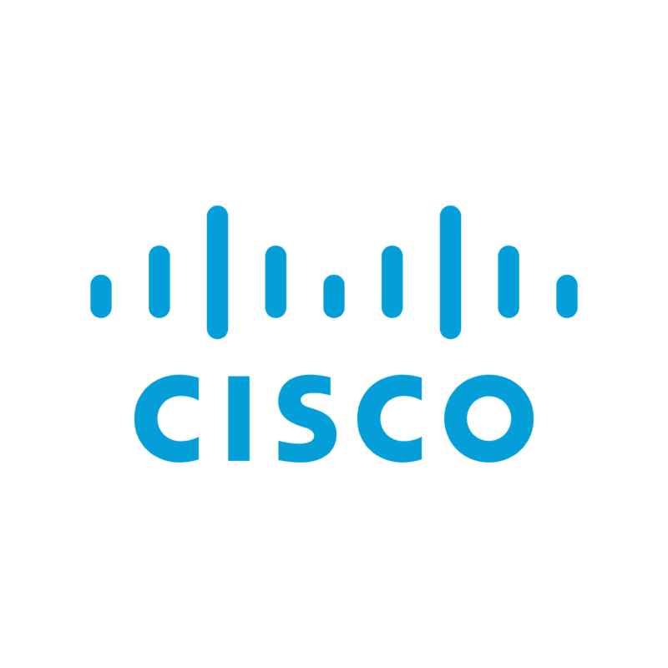
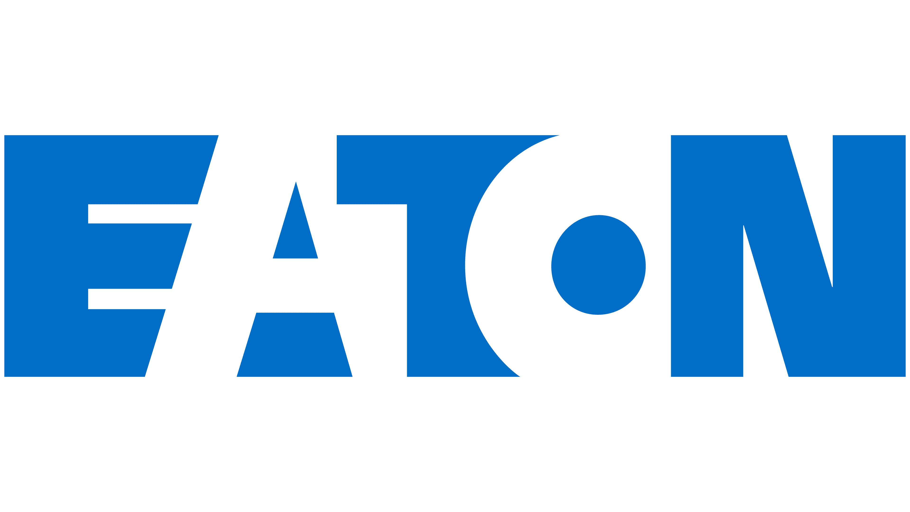





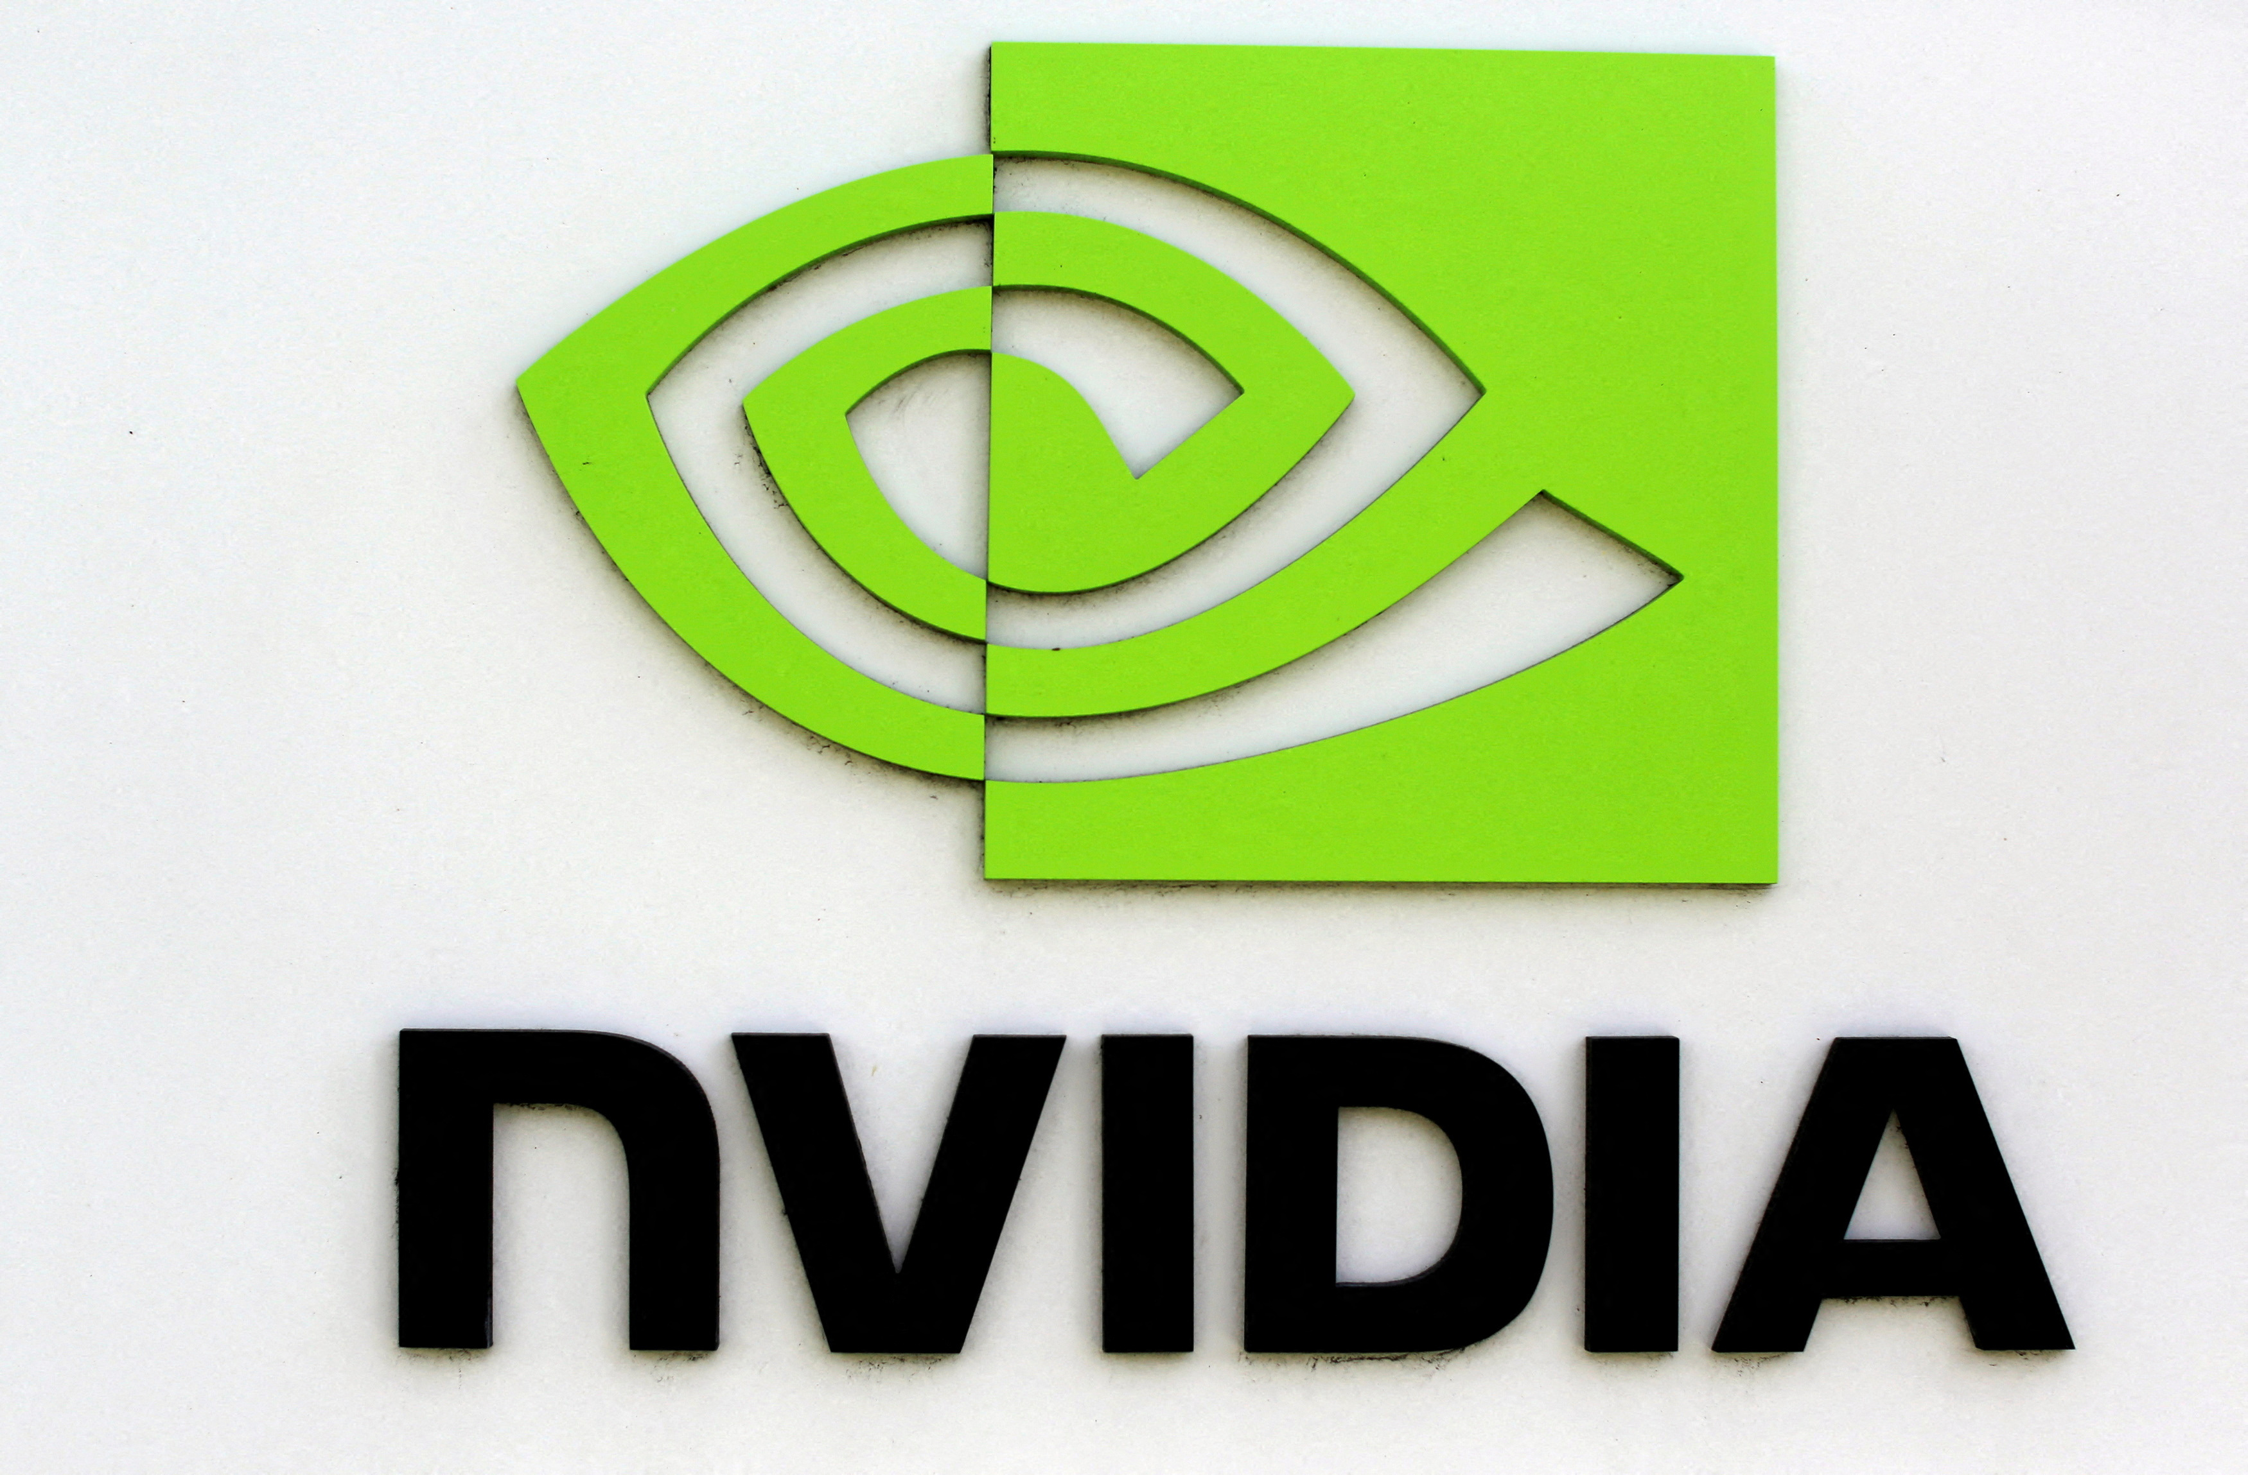






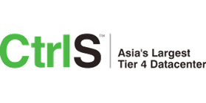




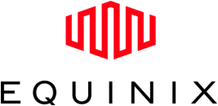






VALUE CHAIN FOR THE DATA CENTER MARKET IN INDIA (1/1)
VALUE CHAIN ANALYSIS
Infrastructure
Power and Cooling Solutions
Data Center Infrastructure
Connectivity
Data Center Services
Security and Compliance
End Users
and Clients
Real Estate Developers
Civil Engineers and Architects
Local Government
Construction Companies
Utility Providers
HVAC Solution Providers
Renewable Energy Companies
Server Provider
Storage Providers
Network Equipment Manufacturers
IT Hardware
Software Vendors
Network Service Providers
Cloud Service Providers
Colocation Service Providers
Managed Service Providers
System Integrators
Cybersecurity Firms
Compliance Consultants
Risk Management Firms
Large Enterprises
Government Agencies
Startups and SMEs

Slide 18
PLANNED AND UPCOMING DATA CENTER OPERATIONS IN INDIA

Slide 19
PLANNED AND UPCOMING DATA CENTER OPERATIONS IN INDIA (1/1)
PLANNED OPERATIONS
FUTURE OPERATIONS
In May 2023, STT GDC set to expand its campus in Pune, India, by developing two new data centers. The company plans to invest $241.9 million in this project (by the end of 2024), which will add 40 MW of capacity to the existing infrastructure.
In September 2024, Adani Group announced a substantial investment of $4 billion to expand its data center business in India, aiming to achieve a target capacity of 1 GW.
In February 2024, CtrlS Datacenters Ltd. announced a significant investment of $482 million to develop a data center park in Chennai, which will be implemented in multiple phases.
In August 2024, Aurum Equity Partners has announced a significant investment of $400 million to develop a data center in Hyderabad, India. This investment will be executed in phases, with the aim of constructing a 100 MW facility designed to serve both hyperscalers and enterprises in the state of Telangana.
Microsoft is reportedly investing $3.7 billion to construct data centers in Telangana, South India, over the next 3-4 years (by 2028). These data centers are set to provide a total capacity of 660 megawatts of information technology (IT potential).
Meta Platforms is planning to establish its first data center in India with a capacity of up to 20 MW, potentially investing $60-$145 million in the project.
In July 2023, Sify Technologies successfully raised $73 million from the Kotak Data Center Fund as part of its ambitious expansion plans. The company is set to invest this fund over the next five to six years (by 2030) in greenfield data center projects.
The UAE and India signed a MoU to develop data centers with a combined capacity of 2 GW. This agreement establishes a framework aimed at enhancing bilateral investment cooperation in the digital infrastructure sector, particularly focusing on data center projects in India.

Slide 20
FUTURE OUTLOOK OF INDIA DC LANDSCAPE

Slide 21


FUTURE OUTLOOK OF INDIA’S DATA CENTER (DC) LANDSCAPE (1/4)
India's data center market is poised for significant growth in the coming years, driven by a combination of factors that align with global digital transformation trends. Here’s a comprehensive look at the outlook:
Robust Growth Projections
Capacity Expansion: The data center capacity in India is expected to reach 2.7 GW by 2027, fueled by the growing demand for cloud services, data storage, and digital applications
Investment Surge: Major players, including domestic and international firms, are planning substantial investments, with billions earmarked for infrastructure development and capacity enhancement
Increased Digital Adoption
Rising Internet Penetration: With over 800 million internet users, India's digital landscape is rapidly evolving, leading to heightened demand for data processing and storage capabilities
Emerging Technologies: The adoption of technologies like IoT, AI, and Big Data will drive the need for advanced data center solutions, further accelerating market growth

Slide 22


FUTURE OUTLOOK OF INDIA’S DATA CENTER (DC) LANDSCAPE (2/4)
Government Initiatives
Supportive Policies: The Indian government is promoting initiatives like Make in India and Digital India, which are conducive to data center growth through incentives and regulatory support
Data Localization: As data localization laws take shape, companies will invest in local data centers to comply with regulations, driving infrastructure expansion
Focus on Sustainability
Green Data Centers: There is a growing emphasis on sustainability, with data centers increasingly adopting energy-efficient technologies and renewable energy sources
Regulatory Pressures: Companies will need to comply with environmental regulations, prompting investments in sustainable practices

Slide 23


FUTURE OUTLOOK OF INDIA’S DATA CENTER (DC) LANDSCAPE (3/4)
Emergence of Tier 2 and Tier 3 Cities
Geographic Diversification: As the demand for data centers expands, Tier 2 and Tier 3 cities are emerging as viable locations due to lower operational costs and incentives from state governments
Local Opportunities: This geographic shift will not only alleviate congestion in Tier 1 cities but also create local employment and support regional economies
Increased Competition
Market Fragmentation: The data center market will see increased competition, with numerous players entering the space. This will lead to innovation and improved service offerings
Partnerships and Collaborations: Companies will increasingly form alliances to enhance capabilities, share resources, and address specific market needs

Slide 24

FUTURE OUTLOOK OF INDIA’S DATA CENTER (DC) LANDSCAPE (4/4)
Technological Advancements
Edge Computing: The rise of edge computing will necessitate the establishment of smaller data centers closer to end-users, improving latency and service delivery
Automation and AI: The integration of automation and AI in data center operations will enhance efficiency, reduce costs, and optimize resource management
The outlook for India's data center market is highly optimistic, marked by strong growth, rising digital adoption, and ample investment opportunities. As the market evolves, stakeholders must remain agile to keep up with technological advancements, regulatory shifts, and sustainability requirements.
Ultimately, India’s data center sector is poised to be instrumental in driving the nation’s digital economy and technological progress in the coming years.

Slide 25
THANK YOU

